Slide 1

STOCK MARKET ANALYSIS
A Comprehensive Stock Analysis Project
By: Shivangi Thakur

Slide 2

Business Objective
To provide insights into the stock market performance of the select major companies.
Through analysis, we aim to identify patterns, trends, and anomalies in the stock’s behaviour over time.
By doing so, we hope to make informed decisions regarding the stock purchases, sales, or holdings, potentially.

Slide 3
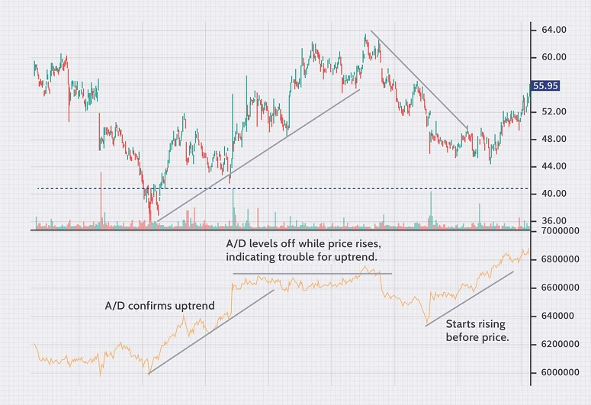

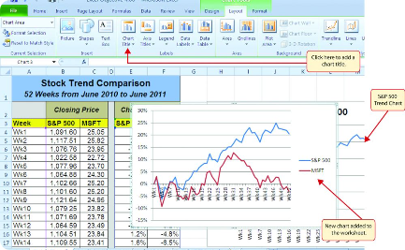
Importance of Data Analysis in Stock Market
Key Metrics Analysis
Risk Assessment
Performance Evaluation
Data analysis allows investors to analyze key metrics such as price-earnings ratio, market cap, and revenue growth, providing valuable insights for making informed decisions.
By analyzing historical data and market trends, data analysis helps in assessing and mitigating investment risks by identifying potential market shifts and fluctuations.
Data analysis enables the evaluation of stock performance over time, helping investors to identify patterns and make strategic investment choices.

Slide 4
KPI 1: Average Daily Trading Volume
Observation
The average daily trading volume varies among the stocks
Inference
The differences in average daily trading volume suggest varying levels of market activity and investor interest for each stock.
Fluctuations in average daily trading volume could be indicative of changes in market sentiment, news, or events affecting specific stocks.

Slide 5
KPI 2: Most Volatile Stocks
Observation
Microsoft Corporation (MSFT) is identified as the most volatile stock whereas Facebook is the least volatile stock.
Inference
1) Microsoft (MSFT) is identified as the most volatile stock among all the stocks available.
2) This suggests higher risk and potential returns. Investigating recent news, market sentiment and fundamentals to understand the drivers of Microsoft's volatility is utmost important.

Slide 6
KPI 3: Stocks With Highest/Lowest Dividend
Observation
Microsoft Corporation (MSFT) has the highest dividend yield among the selected stocks, while Google (GOOGL) has the lowest dividend yield.
Inference
Microsoft pays a lot in dividends, making it good for people who want regular income. Google doesn't pay as much in dividends, focusing more on growing the company, which might be better for those looking for long-term growth in their investment. Choose based on what you want – regular income or potential for the value of your investment to go up over time.

Slide 7
KPI 4: Highest and Lowest P/E Ratio
Observation
Google (GOOGL) has both the highest and lowest Price-to-Earnings (P/E) ratio
Inference
Google's stock is like a rollercoaster for investors – sometimes seen as having great potential (high P/E) and other times as a bit risky (low P/E).
The stock's value swings a lot, so it's important to understand why investors see it differently at different times.

Slide 8
KPI 5: Stocks With Highest Market Cap
Observation
MSFT is the stock with highest market cap of 4,43,17,079 Million.
Inference
Microsoft has the largest market capitalization among the selected stocks, indicating it is currently the most valuable company in terms of total market value.
Investors and the market may have high confidence in Microsoft's business and growth prospects.

Slide 9
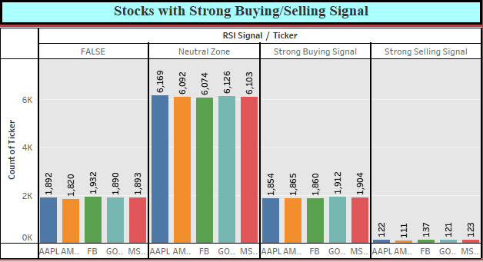
KPI 6: Stocks with Strong Buying/Selling Signal
Observation
Large number of stocks are falling under Neutral Zone suggesting the stability in the price movements.
Inference
1) As per the observation, it could imply that the market is currently in a state of equilibrium or indecision. Investors may be adopting a wait-and-see approach.
2) It's essential to monitor the market conditions closely and be prepared for potential shifts in sentiment that could impact stock movements.

Slide 10
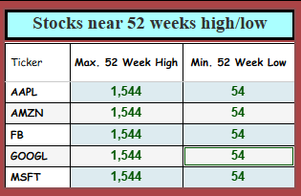
KPI 7: Stocks Near 52 Weeks High/Low
Observation
Every stock has almost same Max/Highest price as well as Min/Lowest price over the past 52 weeks (One year).
Inference
1) Need to check the accuracy of the data or the calculation method.
2) Having identical Max and Min values for all stocks could be an anomaly and may not accurately represent their historical price movements.

Slide 11
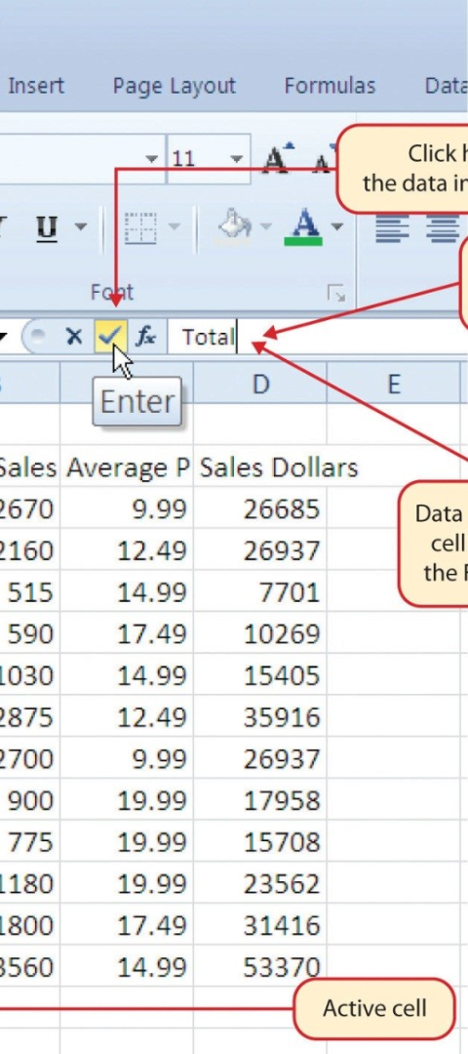

Overview of Excel for Data Analysis
Data Manipulation
Statistical Analysis
Excel provides robust tools for data manipulation, including sorting, filtering, and pivot tables, enabling efficient analysis of stock market data.
With functions like SUM, AVERAGE, and STDEV, Excel allows for statistical analysis of financial data to identify trends and patterns.
Data Visualization
Excel's charting and graph features facilitate the visualization of stock market data for clear and insightful presentations.

Slide 12
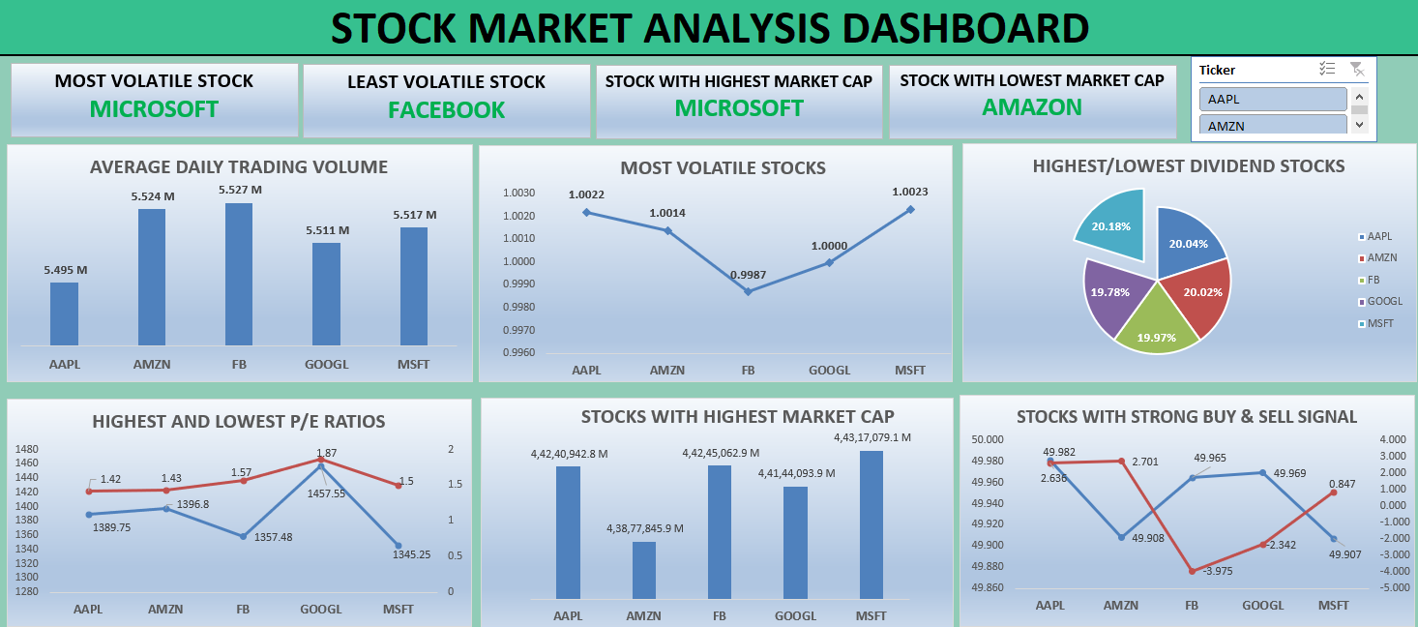
Dashboard : Excel

Slide 13
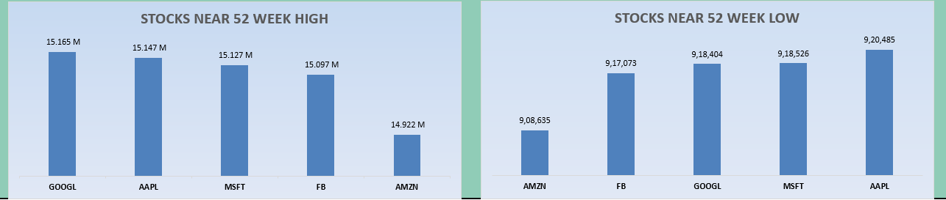
Dashboard : Excel continues…

Slide 14




Using Power BI for Stock Market Data Analysis
Data Integration
Power BI enables integration of stock market data from various sources, consolidating it for comprehensive analysis and reporting.
Interactive Dashboards
With interactive and dynamic dashboards, Power BI facilitates real-time visualization and exploration of stock market trends and patterns.
Advanced Analytics
Power BI's advanced analytical capabilities provide insights into stock performance, market volatility, and investment opportunities.

Slide 15
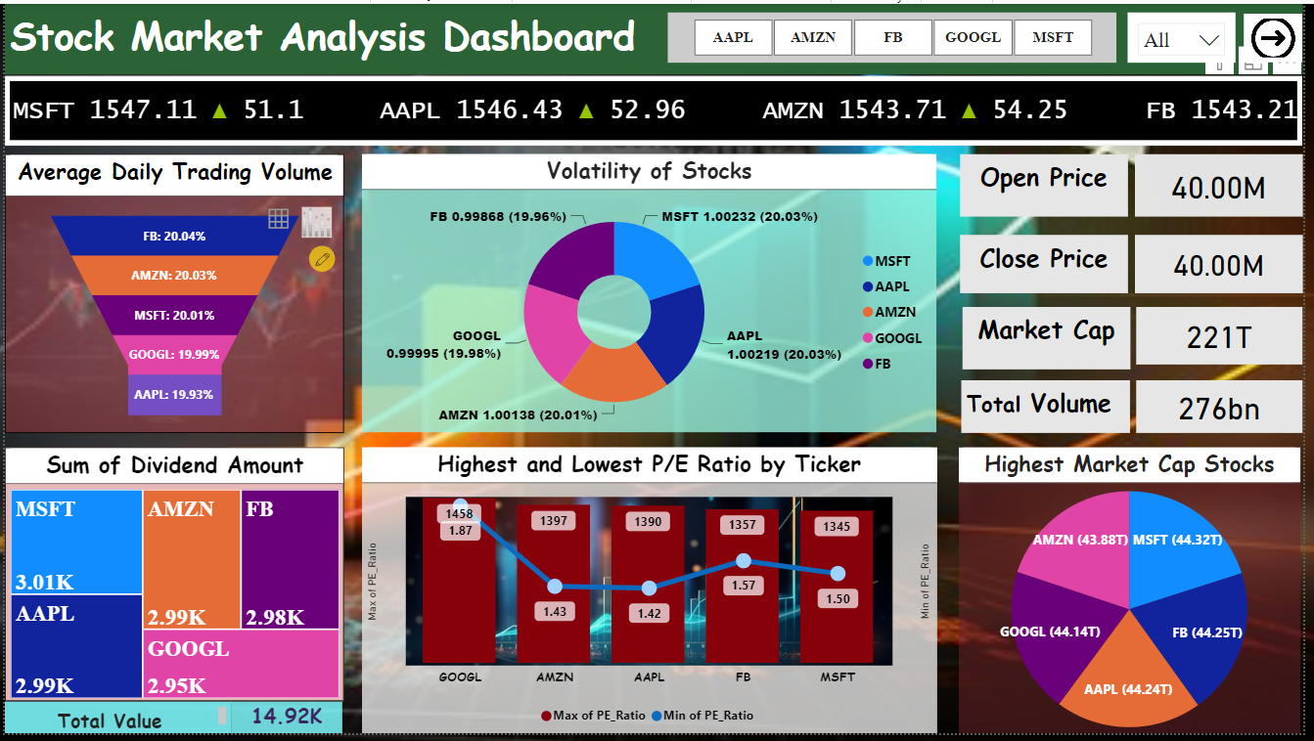
Dashboard : Power BI

Slide 16
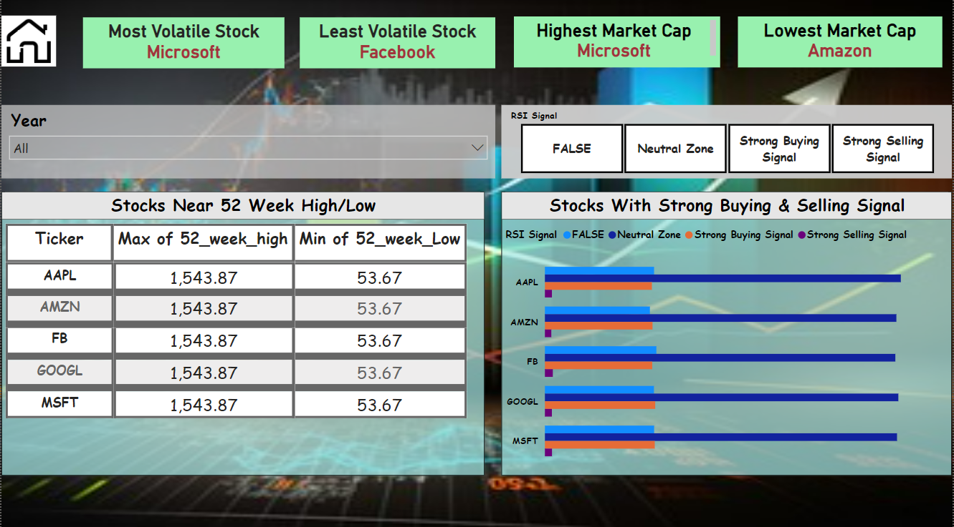

Slide 17
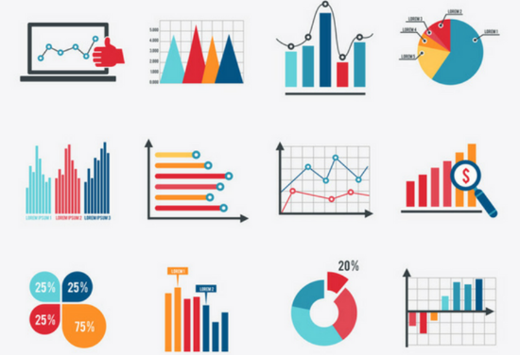
Using Tableau for Visualizing Stock Market Data
Interactive Visualization
Data Storytelling
Tableau enables the creation of interactive and engaging visualizations of stock market data, facilitating in-depth exploration and analysis.
With Tableau's storytelling feature, investors can create compelling narratives based on stock market data, transforming analysis into impactful stories.
Collaborative Analysis
Tableau allows for collaborative analysis, enabling teams to work together on visualizing and analyzing stock market trends and performances.

Slide 18
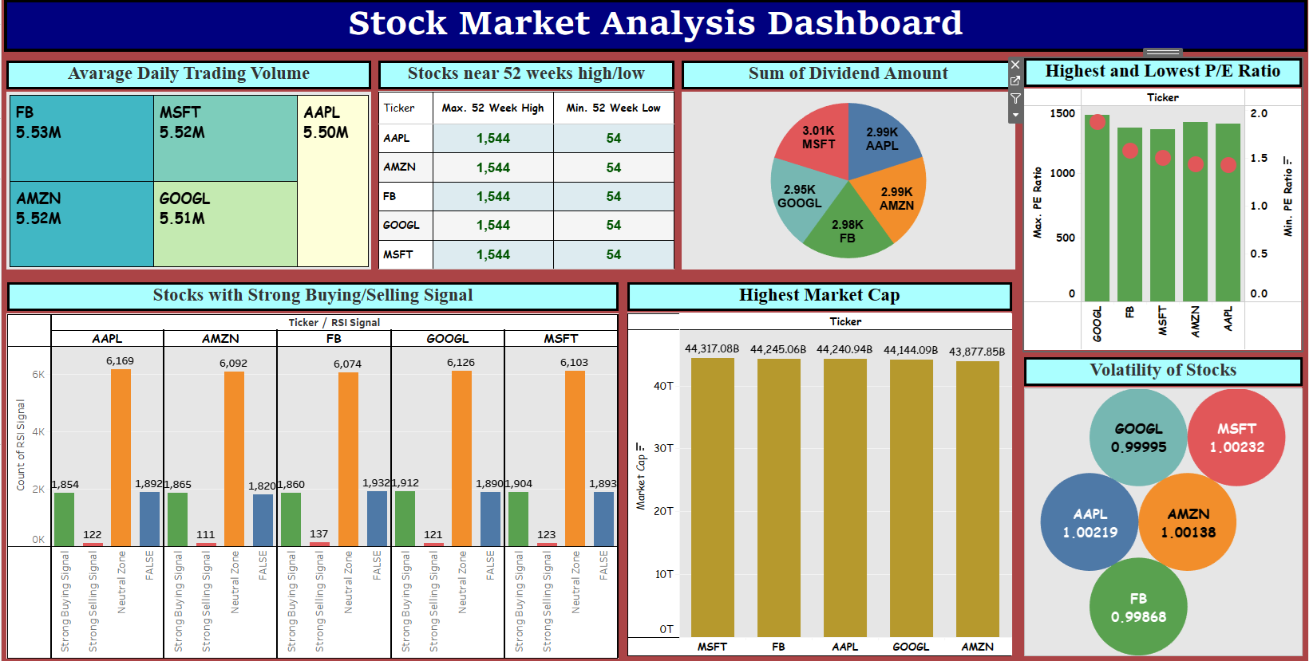
Dashboard : Tableau

Slide 19
Challenges we faced…
1. Limited Data Availability
Insufficient data for meaningful analysis.
Difficulty in obtaining relevant data sources.
2. Lack of Domain Knowledge
Understanding the context and meaning of the data.
Interpreting data correctly without domain expertise.
3. Resource Constraints
The team faces a shortage of skilled personnel due to a reduction
in group members from 7 to 3.

Slide 20
Experiences we gain…
Data Interpretation Skills
Quantitative Analysis Proficiency
Technology and Tools Utilization
Economic and Industry Insights
Continuous Learning and Adaptability
Domain Knowledge
Communication and Presentation Skills
Real-world Application of Academic Knowledge

Slide 21


